Slide 1
BRITISH AIRWAYS

Slide 2
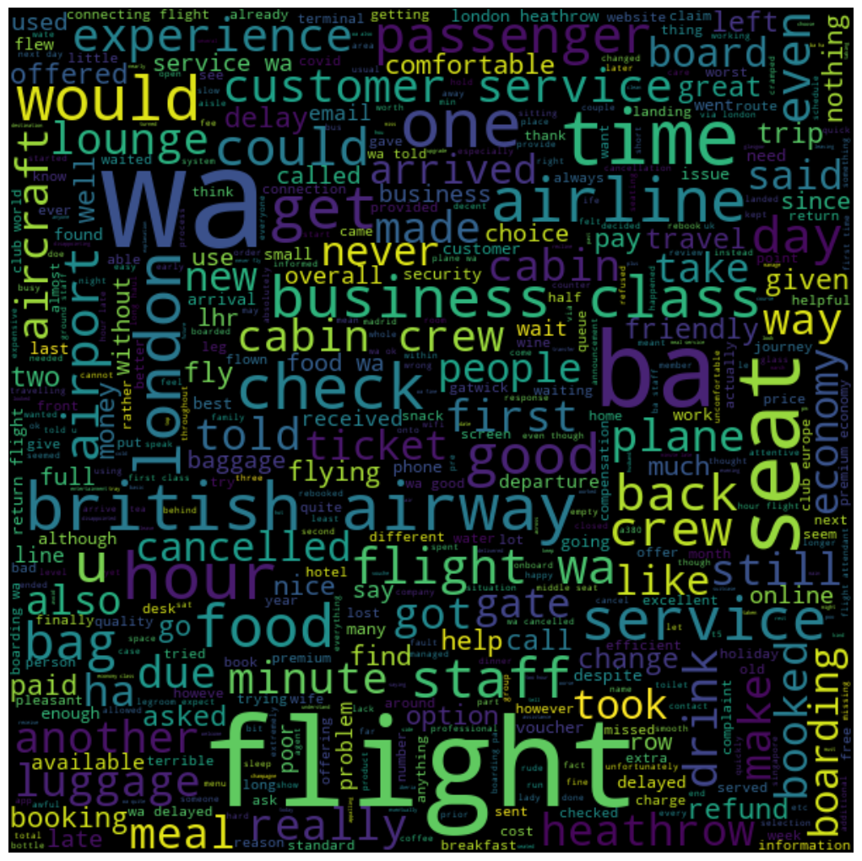
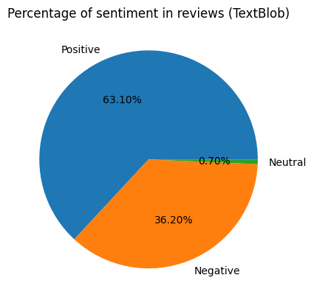
BRITISH AIRWAYS-METRICS
Insights
Out of the thousand reviews scraped, there was an overall 63% general positive sentiment,36% negative sentiment. Over fifty percent of data has more than 1000 characters and the mean words are about 150. The customers were happy about comfortable seats, good inflight entertainment in business class, decent food quality, Cabin crew service and staff in economy class. The negative reviews were around baggage, boarding, meals The topics from topic modelling were about -worst premium, poor infight entertainment in economy class. Focus on – Economy class service, baggage, seats, enhance inflight entertainment experience and importantly Delays. Enhance the experience of business class, customers want value for money. Improve Customer service on refund requests and process.

